Slide 1

JC2001 Introduction to Software Engineering
Lecture 6: System Modeling
Dr Xiao Li xiao.li@abdn.ac.uk (BSc Artificial Intelligence)
Dr Huang Yongchao yongchao.huang@abdn.ac.uk (BSc Business Management and Information Systems)
Dr Edward Chuah thuan.chuah@abdn.ac.uk (BSc Computing Science)

Slide 2
Learning objectives
Understand how graphical models can be used to represent software systems.
Understand the fundamental system modeling perspectives of context, interaction, structure, and behaviour.
Understand the diagram types in the Unified Modeling Language (UML) and how these diagrams can be used in system modeling.
Reference: Ian Sommerville, Software Engineering – Chapter 5, 10th edition, Pearson, 2015.

Slide 3
Outline of lecture
Introduction to system modeling.
Introduction to context models.
Introduction to interaction models.
Introduction to the model-driven architecture.

Slide 4
Definition of system modeling
System modeling is the process of developing abstract models of a system. Each model presents a different perspective of that system. It uses graphical notations based on diagram types in UML.
System models can be developed for existing systems and new systems:
Models of existing systems are used to help clarify what the existing system does. These models can be used to focus a stakeholder discussion on the system’s strengths and weaknesses.
Models of new systems are used to help explain the proposed requirements to other stakeholders. These models can be used to discuss design proposals and document the system for implementation.

Slide 5
Types of system models
Different models can be developed for representing the system from different views:
An external view of the system using a context or environment model.
An interaction view of the system using an interaction model.
A structural view of the system using a model of the organisation of a system or the structure of the data processed by the system.
A behavioural view of the system using a behavioural model to capture how a system responds to events.

Slide 6
Common use of graphical models
There are three ways in which graphical models are commonly used:
To focus discussion among software engineers involved in developing a new system or upgrading an existing system. Informal notations may be used in the models.
To document an existing system. These models document some parts of the system and have to be correct.
To generate a system implementation. These models are detailed system descriptions, and have to be complete and correct. These models are often used as a basis for generating the source code of the system.

Slide 7
Mock quiz
What advantage do system models provide when you are developing an existing system?
Helps clarify what the existing system does.
Helps explain the proposed requirements to other stakeholders.
Helps identify gaps in non-functional requirements.
Helps determine a suitable programming language.
Notes:
Answer is A.

Slide 8
Context models
At an early stage in the specification of a system, you should decide on the system boundaries, that is, on what is and is not part of the system being developed.
This involves working with system stakeholders to decide what functionality should be included in the system, and what processing and operations should be carried out in the system’s operational environment. For example, you may decide that:
Automated support for some business processes should be implemented in the software being developed.
Some new functionality should be implemented to address overlaps in fuctionality with existing systems.

Slide 9
Mentcare system: Context model
The Mentcare system is intended to manage information about patients attending mental health clinics, and the treatments that have been prescribed. In developing the specification for this system, you have to decide whether the system should focus on one of the following:
Collecting information about consultations using other systems to collect personal information about patients, or
The system should also collect personal patient information.
The advantage of relying on other systems for patient information is that it avoids duplicating data.
The disadvantage is using other systems may make it slower to access information.

Slide 10
Mentcare system: Context model
The user base for the Mentcare system is diverse, and users have a wide range of different system requirements.
The list of users include doctors, nurses, receptionists, medical ethics advisor, etc. To cater to the needs of different users, a configurable system that can be adapted to their needs can be developed.
To define the context and the dependencies that a system has on its environment, a simple architectural model can be used.

Slide 11
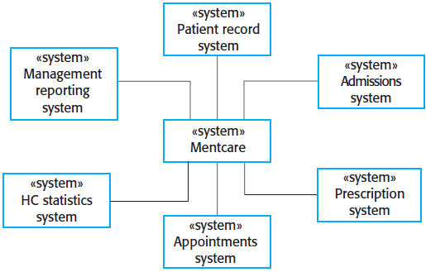
Mentcare system: Context model
An architectural model for the Mentcare system.
Notes:
In this context model, the Mentcare system shares data with the existing Patient record system. It is also connected to existing systems for management reporting, hospital admissions, statistics system that collects information for research, and a prescription system that generates prescriptions for patients medications.

Slide 12
Mock quiz
The Mentcare system pulls patient records from an existing patient information system. While this approach simplifies system development, it also raises some issues. Discuss one such issue.
Notes:
One issue is ensuring confidentiality of the patient’s personal data. Since the Mentcare system uses data from an existing patient records system, the Mentcare system must ensure that (a) the data is secured against theft, (b) only the necessary data attributes are retrieved, (c) only authorised personnel will be allowed to perform data migration, and (d) the data shall only be accessible by authorised persons.

Slide 13

USS Capita data breach – April 2023
USS members national insurance number, title, data of birth, name were stolen.
Breach was suspected to have occurred when data was transferred between different servers.
Data breach cost Capita upto $25 million.
UK lawyers consider bringing a joint claim over the data breach.
Source: www.theguardian.com

Slide 14
Business process model
Business process models are used along with simple context models. Business process models describe human and automated processes in which particular software systems are used.
Context models normally show that the environment includes several other automated systems. However, context models do not show the types of relationships between the systems in the environment, and the system that is being specified.
External systems might produce data for or consume data from the system. They might share data with the system, or they might be connected directly, through a network or not connected at all. They might be physically co-located or located in separate rooms or buildings. All these relations may affect the requirements and design of the system being defined, and so must be taken into account.

Slide 15
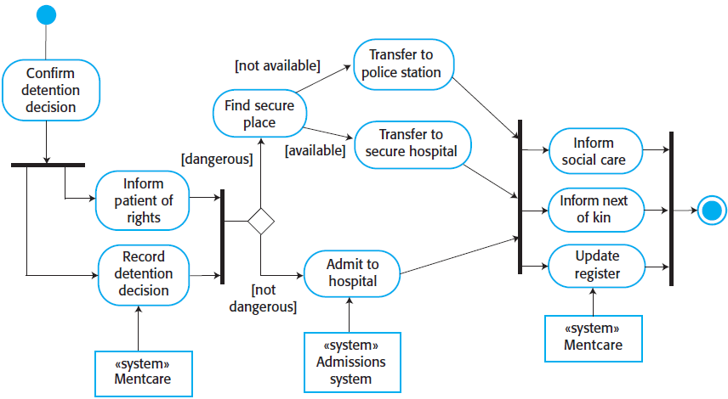
Mentcare system: Process model
A business process model of patient detention, showing by an UML activity diagram.
Notes:
Spend some time in the lecture to explain the model’s workflow.

Slide 16
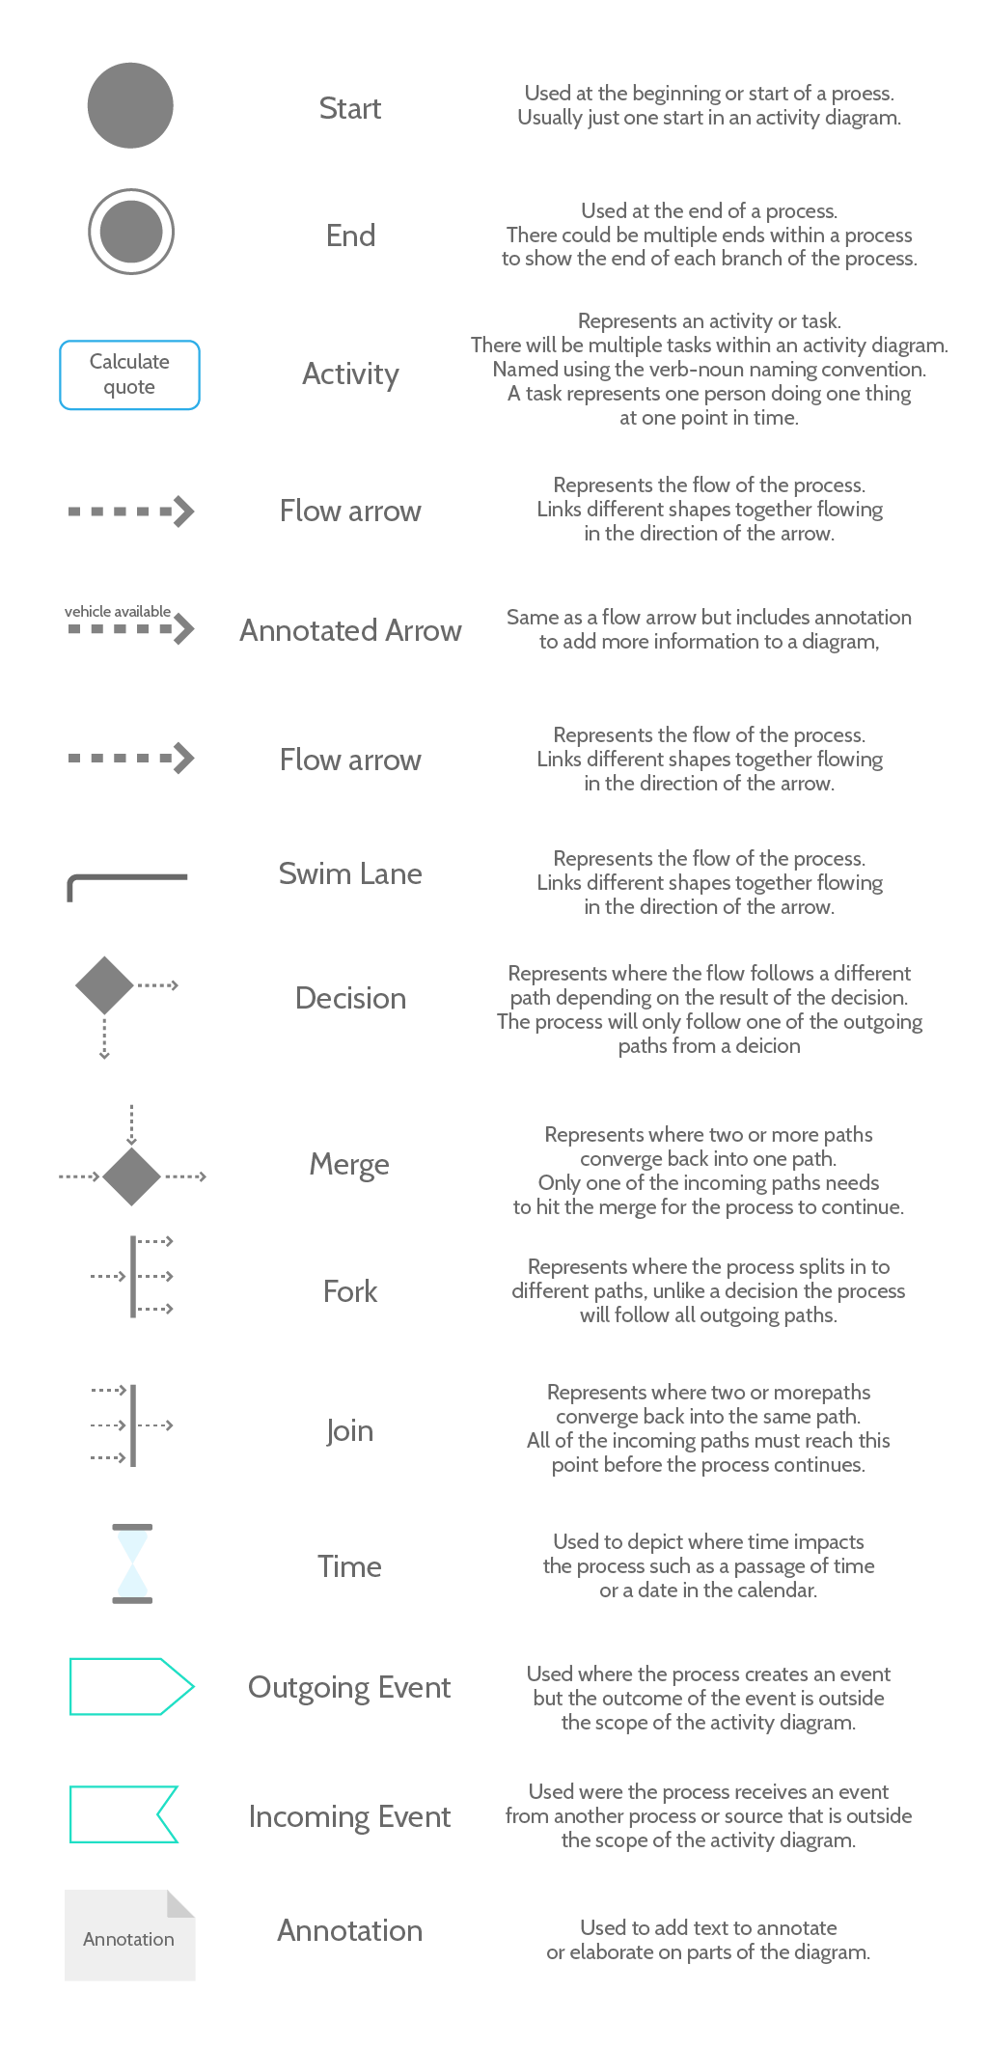
Symbolic representation in UML activity diagrams

Slide 17
Interaction models
All systems involve interaction of some kind. Examples of such interactions include the following:
User interaction, which involves user inputs and outputs.
Interactions between the software being developed and other systems in its environment.
Interactions between the components of a software system.
Interaction modeling is important for the following reasons:
It helps to identify user requirements.
It highlights communication problems that may arise in system-to-system interactions.
It helps to understand if a proposed system structure is likely to deliver the required system performance and dependability.

Slide 18
Mock quiz
Which of the following are reasons for modeling interactions in a computer system?
It helps in identifying system requirements.
It highlights communication problems that may arise in system-to-system interactions.
It helps in understanding if the proposed system structure is likely to deliver the required system performance and dependability.
All of the above.
Notes:
Answer is D.

Slide 19
Interaction modeling approaches
There are two related approaches to interaction modeling:
Use case modeling, which is mostly used to model interactions between a system and external agents (human users or other systems).
Sequence diagrams, which are used to model interactions between system components, although external agents may also be included.
Use case models and sequence diagrams present interactions at different levels of detail, and so they may be used together. For example, the details of the interactions involved in a high-level use case may be documented in a sequence diagram.

Slide 20

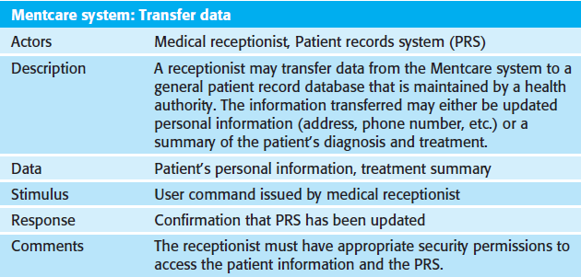
Mentcare system: Use case model
A high-level use case and description for transfer-data.
Notes:
There are two actors in this use case: a medical receptionist and the patient record system. Formally, use case diagrams should use lines without arrows as arrows in UML diagrams indicate the direction of flow of messages. However, the arrows are used informally to indicate that the medical receptionist initiates the transaction and data is transferred to the patients record system.

Slide 21
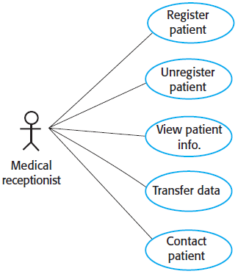
Mentcare system: Composite use case diagram
Composite use case diagrams show a number of different use cases. For example, some use cases in the Mentcare system are:
Register patient.
Unregister patient.
View patient information.
Transfer data.
Contact patient.

Slide 22
Sequence diagrams
Sequence diagrams in the UML are primarily used to model the interactions between the actors and the objects in a system, and the interactions between the objects themselves.
A sequence diagram shows the sequence of interactions that take place during a particular use case. The structure of a sequence diagram is given as follows:
The actors and objects involved are listed along the top of the diagram.
Annotated arrows indicate interactions between objects. The annotations on the arrows indicate the calls to the objects, their parameters, and the return values.
The rectangle on the dotted lines indicates the lifeline of the object concerned.
You read the sequence of interactions from top to bottom.

Slide 23
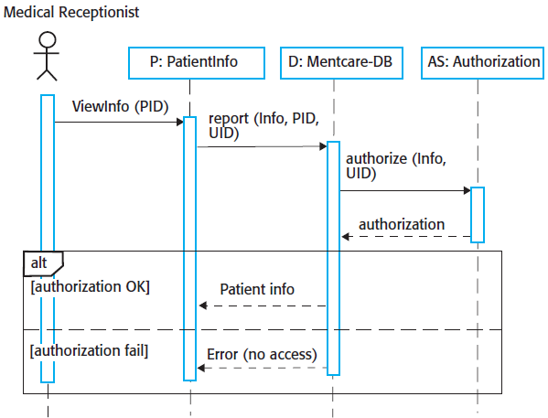
Mentcare: Sequence diagram for View patient info
This sequence diagram can be read as follows:
The medical receptionist triggers the ViewInfo method in an instance of P of the PatientInfo class, supplying the patient’s identifier, PID to identify the required information. P is a user interface object, which is displayed as a form showing patient information.

Slide 24
Mentcare: Sequence diagram for View patient info
This sequence diagram can be read as follows (cont’d):
The instance P calls the database to return the information required, supplying the receptionist’s identifier to allow security checking.
The database checks with an authorisation system that the receptionist is authorised for this action.

Slide 25
Mentcare: Sequence diagram for View patient info
This sequence diagram can be read as follows (cont’d):
If authorised, the patient information is returned and is displayed on a form on the user’s screen.
If authorisation fails, then an error message is returned. The box denoted ``alt’’ in the top-left corner is a choice box indicating that one of the contained interactions will be executed. The condition that selects the choice is shown in square brackets.

Slide 26
Sequence diagrams
Unless you are using sequence diagrams for code generation or detailed documentation, you don’t have to include every interaction in these diagrams.
If you develop system models early in the development process to support requirements engineering and high-level design, there will be many interactions that depend on implementation decisions.

Slide 27
Event-driven modeling
Event-driven modeling shows how a system responds to external and internal events. It is based on the assumption that a system has a finite number of states and that events may cause a transition from one state to another. For example, a system controlling a valve may move from a state ``Valve open’’ to a state ``Valve closed’’ when an operator command is received. Event-driven modeling is used extensively when designing and documenting real-time systems.
In UML, event-based modeling is supported using state diagrams, which are based on state charts. State diagrams show system states and events that cause transitions from one state to another. They do not show the flow of data within the system, but may include additional information on computations carried out in each state.

Slide 28
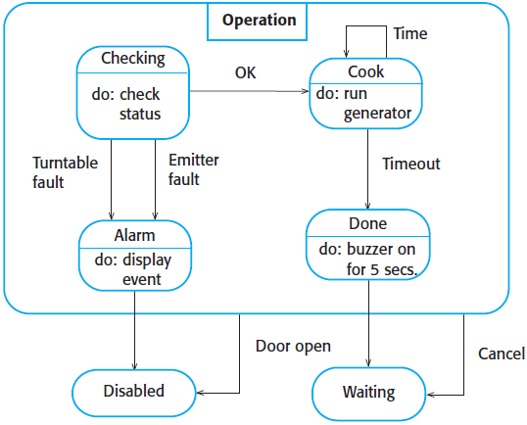

State model
A simple oven has a switch to select full or half power, a numeric keypad to input the cooking time, a start/stop button, and an alphanumeric display.
Using the microwave oven:
Select the power level.
Input the cooking time using a numeric keypad.
Press Start and the food is cooked for the given time.
State-based modeling is susceptible to the problem of rapid increase in the number of possible states. To address this issue, ``super states’’ that encapsulate a number of separate states can be used.
Round rectangles represent system states.
Labeled arrows represent events.

Slide 29
State model

Slide 30
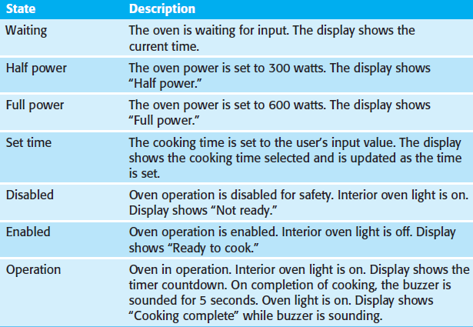
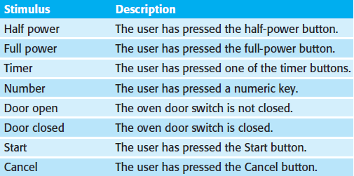
State description and stimulus
State models provide an overview of event processing, but a more detailed description of the system states and stimuli is required for extending the state models.

Slide 31
Model-driven architecture
Model-driven architecture (MDA) is a model-focused approach to software design and implementation that uses a subset of UML models to describe a system. Models at different levels of abstraction are created.
The MDA method recommends that three types of models should be produced:
Computation independent model. These models model the important domain abstractions used in a system, and are sometimes called domain models.
Platform-independent model. These models model the operation of the system without reference to its implementation.
Platform-specific model. These models are transformations of the platform-independent model with a separate platform-specific model for each application platform.

Slide 32
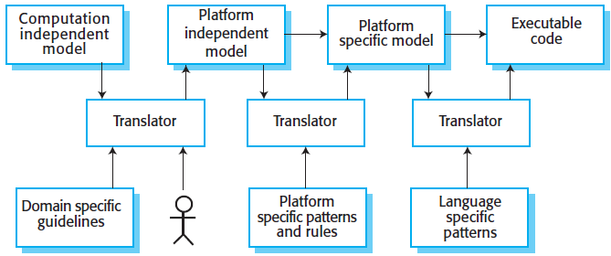
MDA transformations
Fundamental to MDA is the notion that transformations between models can be defined and applied automatically by software tools.
A translator is applied to models to generate execution code that will run on the designated software platform. However, it is difficult to automatically transform models into execution code, so the need for human intervention.

Slide 33
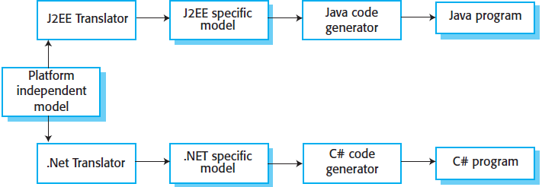
MDA transformations
The translation of platform-independent to platform-specific models is a simpler technical problem. Commercial tools and open-source tools are available that provide translators from platform-independent models to common platforms such as Java, J2EE, .NET, etc. An extensive library of platform-specific rules and patterns can be used to transform these models.

Slide 34
Lessons learned
We described the system modeling process, described the types of system model, and their uses.
We gave details of context and interaction models, and presented examples of these models.
We described the model-driven architecture and its various models.

